Slide 1
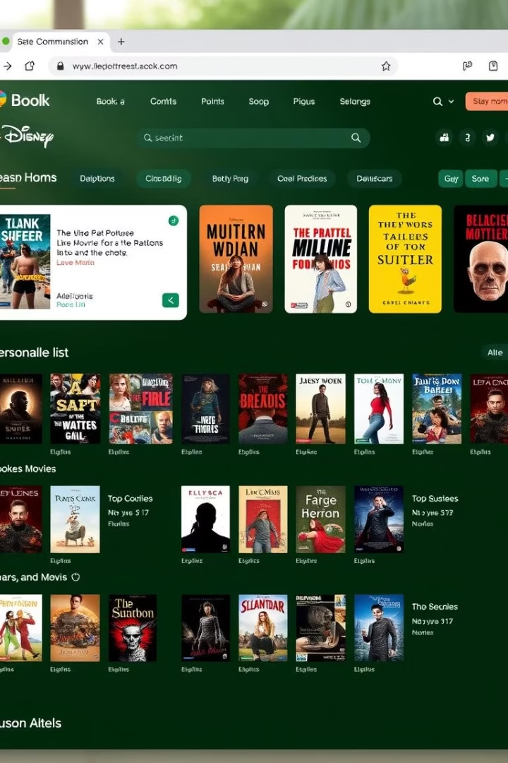
Syntra FXT GroepsWerk 2025: Personalized Wish/Watch-List Web Application
This project delivers a personalized wish/watch-list app for books and movies. Users can add, edit, and delete items with ease.
The app includes calculations like average pages per book and list completion percentage. These enrich user engagement and tracking.

Slide 2

Team Roles and Specializations
Timothy
Xander
UI Design and Security
Data Layer & Objects, Database
Ensures a visually appealing and intuitive user interface for smooth interactions.
Builds robust data storage and defines the application's object models.
Felix
Logic Layer, API, Security
Develops business logic and API integration, ensuring secure data handling.

Slide 3
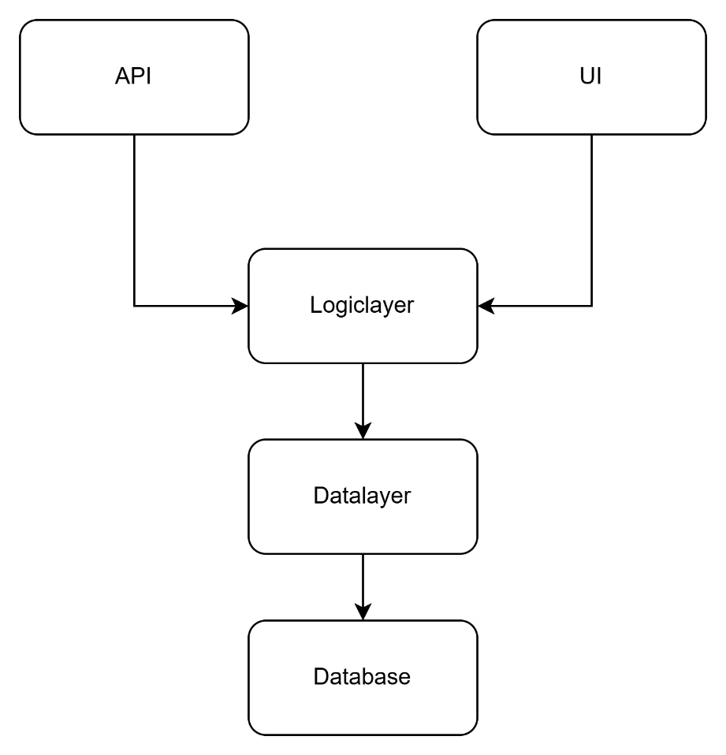




Multilayered Architecture Overview
UI Layer (ASP.NET MVC)
Handles user interactions, displaying data based on Logic Layer inputs. Keeps UI code simple and maintainable.
API Layer
Serves as a parallel layer connecting external data sources for automated data fetching and integration.
Logic Layer
Implements business rules and calculations. Controls app actions like completion percentage computations.
Data Layer
Handles SQL database communication and data integrity. Abstracts storage details from other layers.

Slide 4


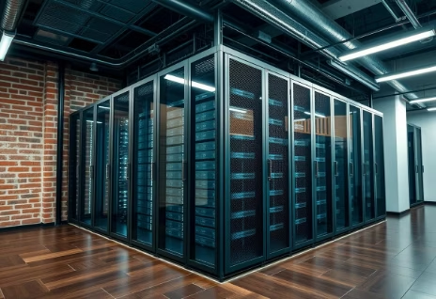
Benefits of Dependency Injection (DI)
Loosely Coupled Code
Improved Testability
Allows component swapping with minimal changes using interfaces.
Enables mock service injection, facilitating isolated unit tests.
Better Maintainability
Centralized service registration simplifies project management and updates.

Slide 5

Technology Stack Overview
Visual Studio
SQL Server
Integrated IDE supporting ASP.NET, .NET, SQL, and Git version control.
Reliable RDBMS with strong query capabilities and easy setup.
ASP.NET Core MVC
Git
Framework promoting clean separation of concerns in web apps.
Version control system enabling efficient team collaboration.

Slide 6

Future Enhancements and Next Steps
1
Security Implementation
Integrate robust user authentication mechanisms and implement role-based access control to ensure data protection and compliance with security standards. This will safeguard sensitive user information and application integrity.
UI Improvements
2
Enhance the user interface with improved styling, dynamic animations, and advanced filtering and sorting capabilities. These enhancements will provide a more intuitive and visually appealing user experience, making the application easier and more enjoyable to navigate.
Scalability & Performance
3
Optimize database queries and refine application logic to improve overall performance and ensure the application can efficiently handle a growing number of users and data. This includes exploring caching strategies and load balancing for future expansion.

Slide 7

API Layer: Integration and Impact
External Data Integration
Pulls live movie and book data, automating data input and improving accuracy.
Parallel Architecture Layer
Operates alongside logic and data layers to enhance scalability and modularity.
Supports Extensibility
Enables addition of new data sources without disrupting core functionalities.
Security & Performance
Facilitates secure API communication and optimizes response handling.

Slide 8

Conclusion: Project Achievements and Future Outlook
Flexible, Scalable Architecture
Clear Division of Responsibilities
Future-Proof Design
Designed to support future expansion and feature growth seamlessly.
Each team member led critical layers ensuring efficiency and accountability.
Built with DI, layered structure, and API/security plans for ongoing refinement.
Syntra FXT GroepsWerk 2025 offers a maintainable, robust web app with strong foundations.

